Slide 1
ANACP Youth Volunteer training
CME pre-activity, post-activity documents
3/3/2024
Dr. Tao Wang

Slide 2
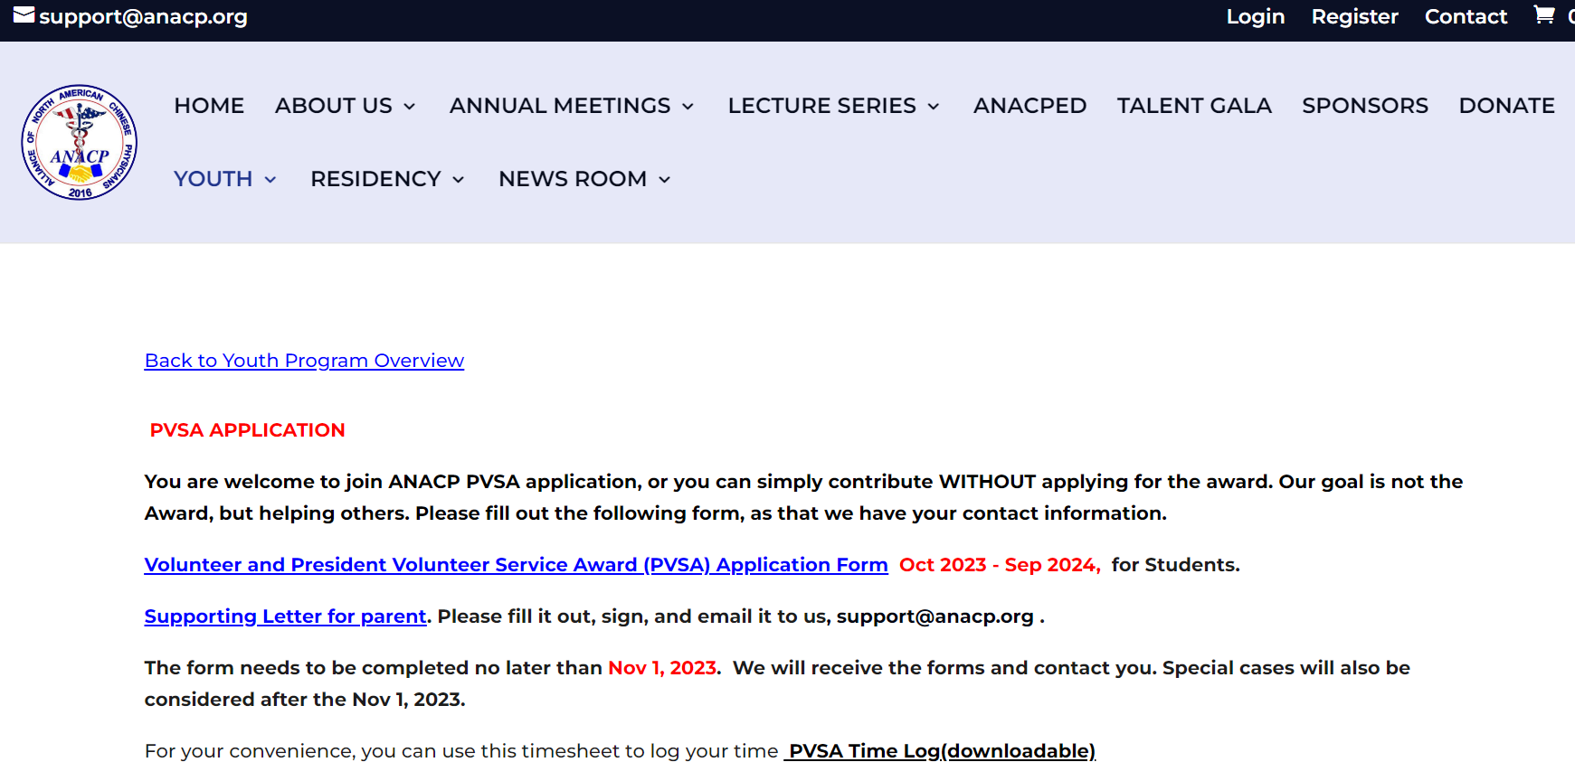
ANACP President Volunteer Service Award (PVSA)
https://www.anacp.org/pvsa/

Slide 3

Continuing Medical Education (CME)
Maintenance of certification (MOC)

Slide 4


ANACP
2024 Lecture Series

Slide 5
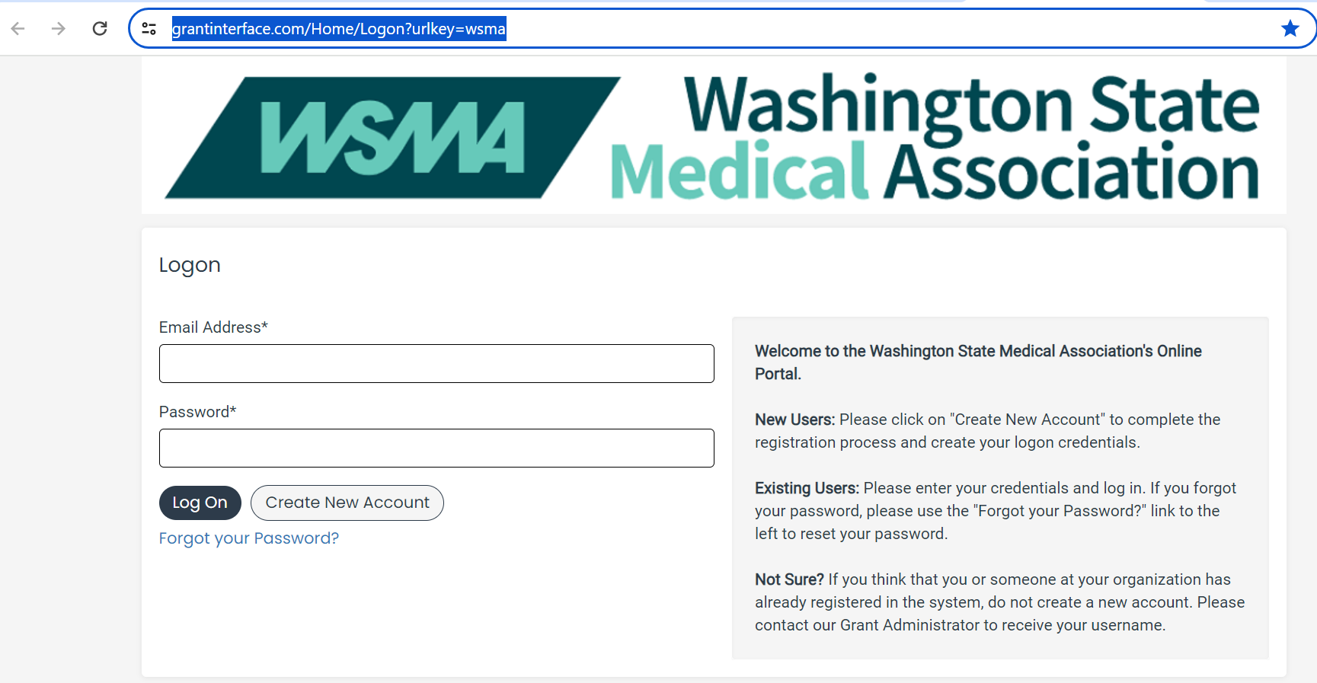
Pre-activity Form
https://www.grantinterface.com/Dashboard/Applicant

Slide 6
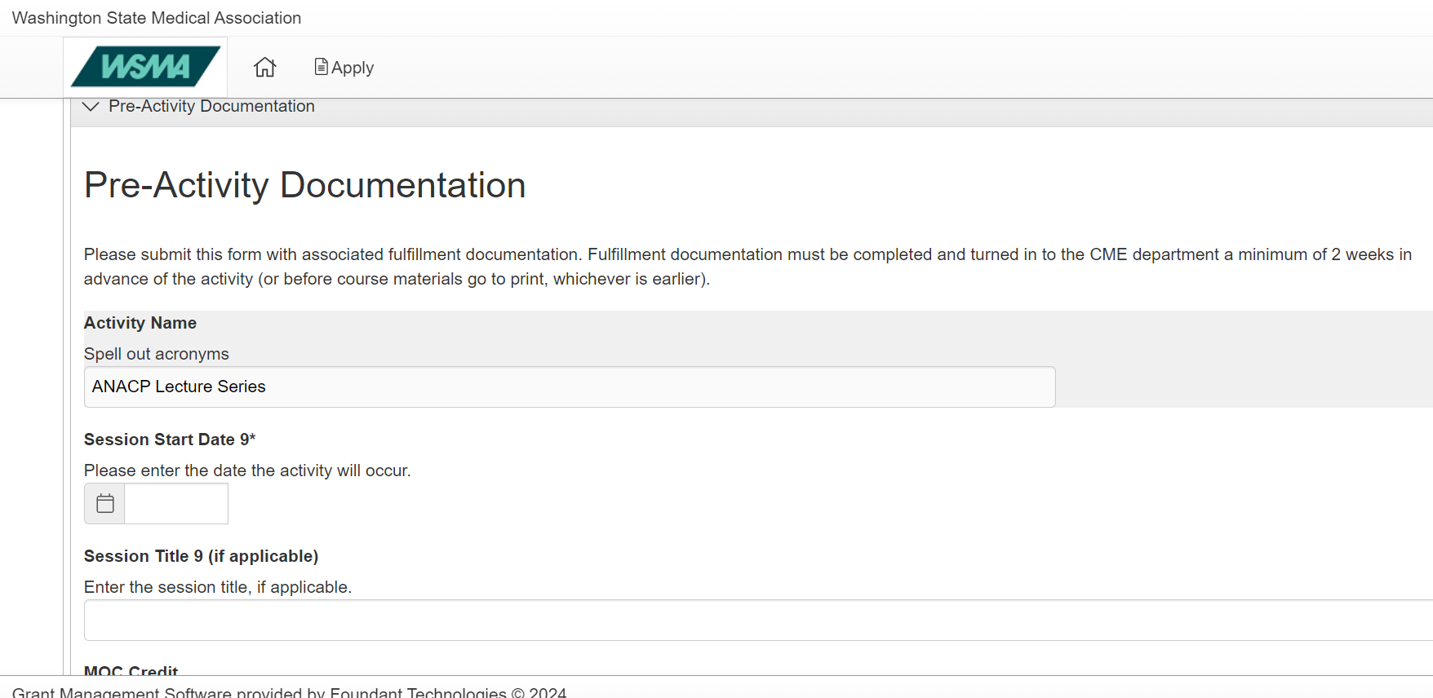
Pre-activity Form

Slide 7
Pre-activity Form
Required Documents
Presentation
Disclosure Statement
Accreditation statement
Evaluation Form
WSMA CME Individuals in Control.xlsx
Flyer

Slide 8


https://www.canva.com/design/DAFy8toDjiU/AQVWxX13aSzBIWUIRAIYtA/edit
讲座幻灯

Slide 9
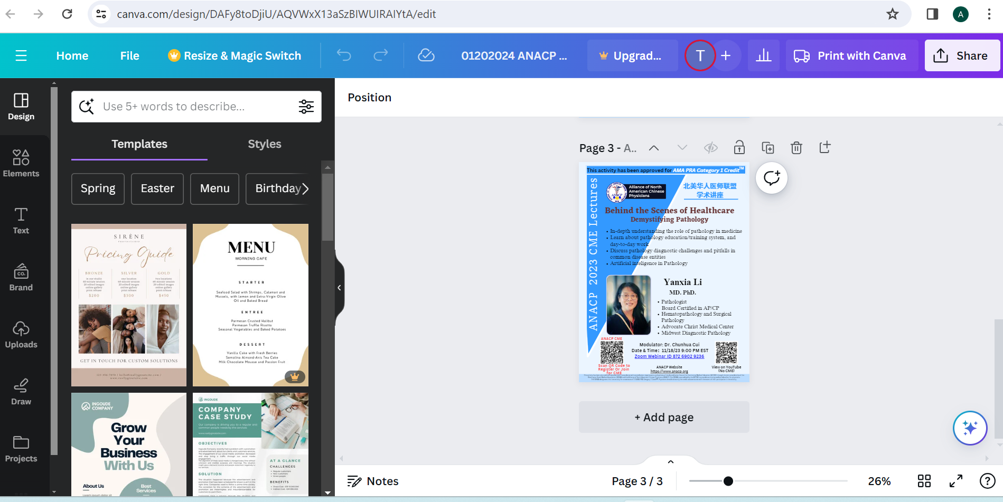
Pre-activity Form Flyer

Slide 10
Pre-activity Form Flyer
Time of the Lecture
Webinar QR code
Presenter’s headshot
Presenter’s title
Lecture Title
Lecture highlight
Expectation:
To Finalize Flyer within 3 days

Slide 11
讲座幻灯

Slide 12
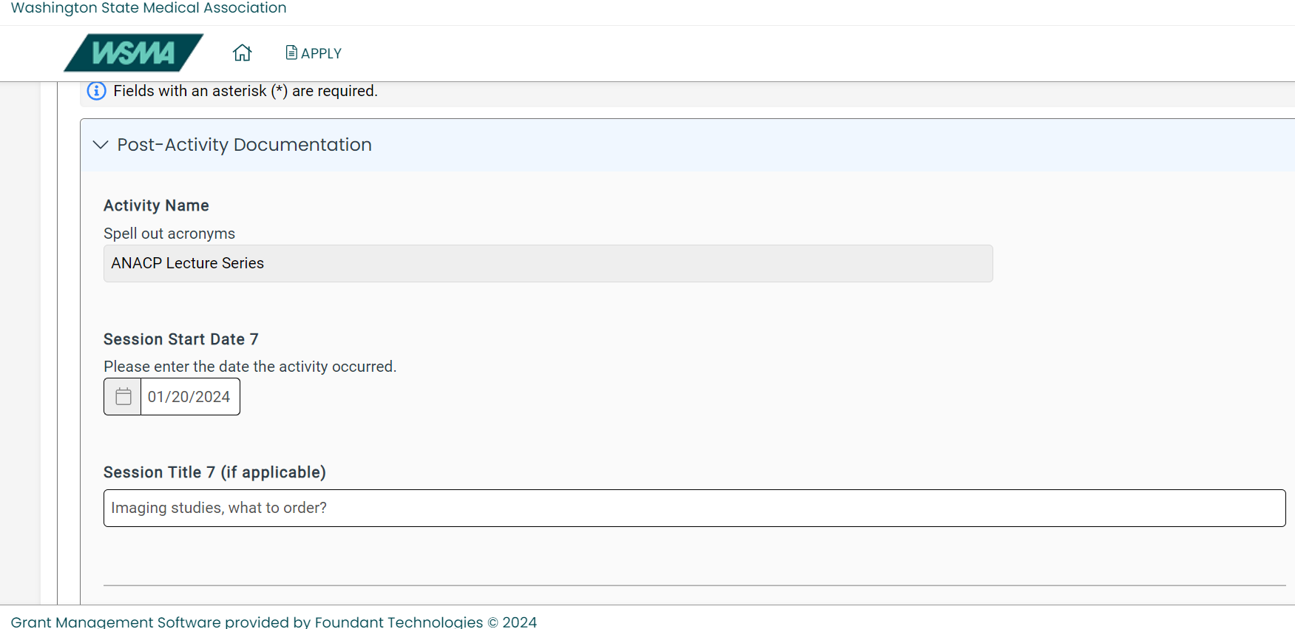
Post activity form
https://www.grantinterface.com/Dashboard/Applicant

Slide 13
Post activity form
Required Documents
Attendance Tracking
Credit Claimed Records
Summarized Evaluation

Slide 14
Post activity form Attendance Tracking
Zoom Webinar export “attendee Report” excel file (provided)
Delete the names who were not at the meeting
Delete irrelevant data
Sort names (First, Last) from A-Z
Delete duplicated names
Save file as “MM-DD-YY Attendee Report”

Slide 15
Post activity form Credit Claimed Records
CME credit claim Excel (Provided)
Transpose data on Excel
Generate two copies

Slide 16
Post activity form Credit Claimed Records
Copy #1:
Sort the names from A-Z to match with the attendee report
Separate the attendance who did not claim CME
Put them at the lower portion of the name list (Labeled as “present” on the final submission)

Slide 17
Post activity form Summarized Evaluation
Copy #2
Record the “quiz response”.
Clean up irrelevant data
Save as a PDF file as
[mm-dd-yy post activity evaluation. [pdf]

Slide 18
Post activity form
How to Transpose data on Excel?
“Copy” the cell range of your desired.
Select the empty cells where you want to paste the transposed data.
On the Home tab, click the Paste icon, and select Paste Transpose.

Slide 19
Raw data of each Webinar will be sent to your via email
Organized data can be sent back to
cme.anacp@gmail.com
Expectation:
To Finalize Data within 7 days

Slide 20





Slide 21

北美华医联盟2023年年会 （西雅图）

Slide 22



<相聚金秋>
芝加哥

